Slide 1
Time Synchronization Protocols in WSN

Slide 2
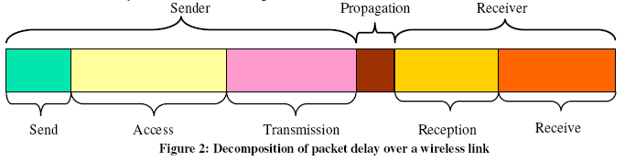
Challenges for Synchronization Methods
Network time synchronization methods rely on message exchange between nodes.
Various kinds of delays need to be considered.

Slide 3
Requirements on Time Synchronization in WSN
Energy Efficiency
Precision
Robustness – what if some nodes fail?
Scalability – does the synchronization scheme scale well with the increasing number of nodes?
Lifetime – synchronization algorithm should last as long as the operation time of the network

Slide 4
Requirements (cont.)
Scope – provide global time-base for all nodes in the network or only provide local synchronization among spatially close nodes.
Cost and size – what kind of hardware will be used in the algorithm?
Immediacy – real time situation handling

Slide 5
Reference Broadcast (RB)
Uses a transmitter node to synchronize the clocks of the receiver nodes to each other.
Timestamps messages only on the receiver side.
For the multi-hop scenario, extra coordination of reference broadcasters is needed.

Slide 6
Tiny-Sync and Mini-Sync
Relationship of the 2 timers can be expressed as:
Use the conventional two-way messaging scheme to estimate the relative drift and offset between the clocks of two nodes.

Slide 7

Tiny-Sync and Mini-Sync (cont.)
Node 1 sends a probe message to node 2, timestamped with t0, the local time just before the message is sent. Node 2 generates a timestamp when it gets the message at tb, and immediately sends back a reply message. Finally, node 1 generates a timestamp tr when it gets this reply message. The following inequalities can be obtained:
(t0; tb; tr) is called a “data point"

Slide 8
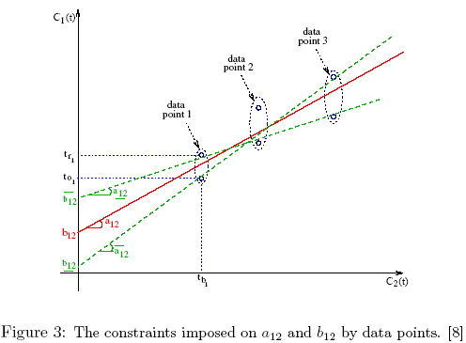
Tiny-Sync and Mini-Sync (cont.)
By using a set of “data points” and some kind of math methods, the algorithm will try to approximate relationship between the 2 clocks.

Slide 9
Timing-Sync Protocol for Sensor Networks (TPSN)
2 phases are used.
In first phase, a hierarchical topology is formed. Each node is assigned a level in this structure.
Root node is assigned to level 0.
Once the structure has been established, the root node initiates the second phase ‘synchronization phase’.
In second phase (synchronization phase), a node belongs to level i is synchronized with a node belonging to level i-1 and eventually, all nodes are synchronized with reference to the root node.

Slide 10
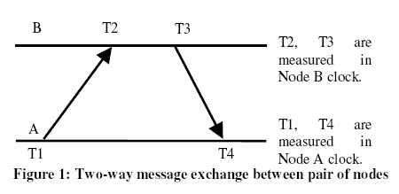

TPSN – How is Timer Synchronized
Node B receives this packet at T2, where T2 is equal to T1 + D + d. Here D and d represents the clock drift between the two nodes and propagation delay respectively.
‘A’ can calculate the clock drift and propagation delay as:
Sender initiated approach.

Slide 11
Lightweight Time Synchronization (LTS)
Distinguished from other work in the sense that the aim is not to maximize accuracy, but to minimize the complexity of the synchronization.
Quite similar to TPSN. The central synchronization method in the protocol is called ‘pair-wise synchronization’ which uses 2 messages to synchronize.
But for the multi-hop scenario, it has 2 methods: ‘Centralized Multi-hop LTS’ and ‘Distributed Multi-hop LTS’.

Slide 12
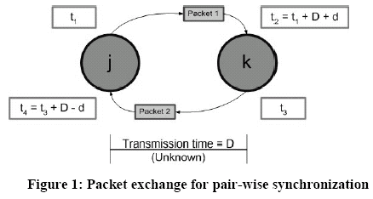
LTS - Pair-wise Synchronization
Almost exactly the same as in TPSN, it uses 2 messages to synchronize the timers between a pair of sensors:

Slide 13
LTS - Centralized Multi-hop LTS
Similar to TPSN, it needs a spanning tree to be constructed first.
The reference node is the root of the spanning tree and has the responsibility of initiating a “resynchronization" as needed.

Slide 14
LTS - Distributed Multi-hop LTS
Each node decides the time for its own synchronization, and a spanning tree structure is not used in this algorithm.
When a node i decides that it needs to synchronize, it sends a synchronization request to the closest reference node.
Then, all nodes along the path from that reference node to i will be synchronized before node i can be synchronized.

Slide 15
The Flooding Time Synchronization Protocol (FTSP)

Slide 16
Time-Stamp Synchronization (TSS)
The basic idea of the algorithm is not to synchronize the local computer clocks of the devices but instead generate time stamps using unsynchronized local clocks.
When a message containing a time stamp is transferred between devices, the time stamps are first transformed from the local time to UTC (which is used as a common time transfer format) and then to the local time of the receiver.

Slide 17

Time-Stamp Synchronization (TSS)
Transforms time stamps exchanged between nodes inside messages to the local time of the receiver instead of adjusting the clocks:
N_{i}
N_{j}
distance
h_{a}^{i}
d₁
Time-stamped request
h_{a}^{j}
d₁’
h_{b}^{i}
h_{b}^{j}
Time-stamped reply
D ^{i}
D ^{j}
d₂
h_{c}^{i}
h_{c}^{j}
d₂’
h_{d}^{j}
h_{d}^{i}
time
h ^{i}
h ^{j}

